Slide 1

Oracle 12c: SQL
Chapter 5
Data Manipulation and Transaction Control
©2016. Cengage Learning. All rights reserved.

Slide 2
Objectives
Use the INSERT command to add a record to an existing table
Manage virtual columns in data manipulations
Use quotes in data values
Use a subquery to copy records from an existing table
Use the UPDATE command to modify the existing rows of a table
Use substitution variables with an UPDATE command
©2016. Cengage Learning. All rights reserved.

Slide 3
Objectives (continued)
Delete records
Manage transactions with transaction control commands COMMIT, ROLLBACK, and SAVEPOINT
Differentiate between a shared lock and an exclusive lock
Use the SELECT…FOR UPDATE command to create a shared lock
©2016. Cengage Learning. All rights reserved.

Slide 4

Insert into ACCTMANAGER table
Oracle 11g

Slide 5
INSERT Command
Used to add rows to existing tables
Identify the table in the INSERT INTO clause
Specify data in the VALUES clause
Can only add one row at a time to a table
©2016. Cengage Learning. All rights reserved.

Slide 6
INSERT Command Syntax
Enclose nonnumeric data in single quotes
If a column list is not provided, a value must be assigned to each column in the table
©2016. Cengage Learning. All rights reserved.

Slide 7
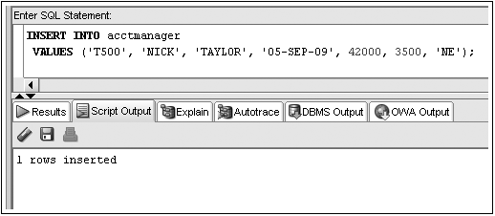
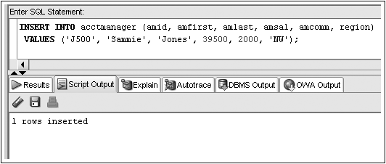
INSERT Command Examples
No Column List
Column List
Notes:
INSERT INTO acctmanger
VALUES (‘T500’, ‘NICK’, ‘TAYLOR’, ‘05-SEP-09’, 42000, 3500, ‘NE’)

Slide 8
Insert into ACCTMANAGER table
Oracle 11g

Slide 9
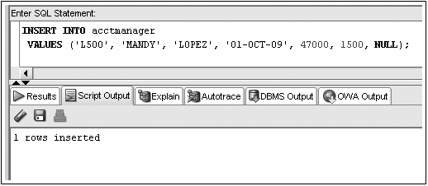
Inserting NULL Value
Omit column name from INSERT INTO clause column list
Substitute two single quotation marks
Use NULL keyword
NULL value input
©2016. Cengage Learning. All rights reserved.
Notes:
INSERT INTO acctmanger
VALUES (‘T500’, ‘MANDY’, ‘LOPEZ’, ‘01-OCT-09’, 47000, 1500, NULL)

Slide 10

Methods of inserting NULL Values
Oracle 11g

Slide 11
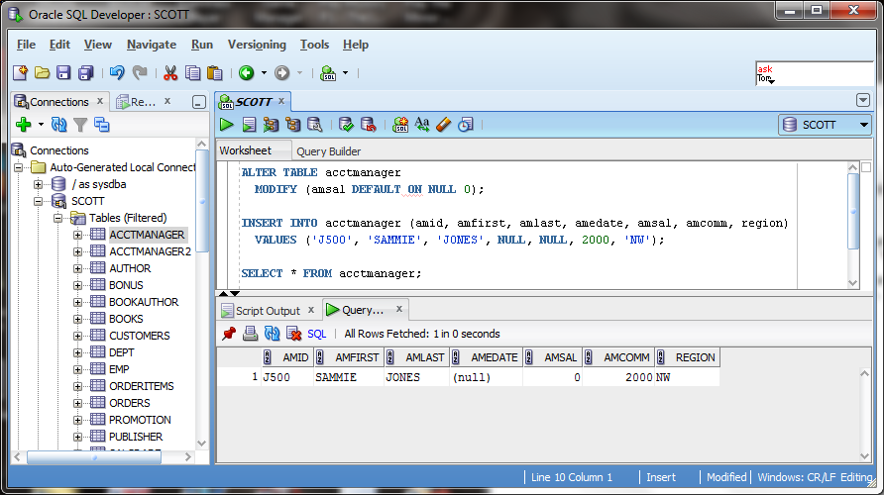
ON NULL Clause
Introduced in Oracle 12c
Option with a DEFAULT setting
©2016. Cengage Learning. All rights reserved.

Slide 12
Using DEFAULT
Oracle 11g
Notes:
INSERT INTO acctmanger (amid, amfirst, amlast, amsal, amcomm, region)
VALUES (‘J500’, ‘SAMMIE’, ‘JONES’, 39500, 2000, ‘NW’)

Slide 13
Activating the DEFAULT option
Include a column list in the INSERT statement ignoring the column to use the DEFAULT option
Use the DEFAULT keyword as the value for the column
©2016. Cengage Learning. All rights reserved.

Slide 14

Using DEFAULT
No amedate column
Oracle 11g
Notes:
INSERT INTO acctmanger (amid, amfirst, amlast, amsal, amcomm, region)
VALUES (‘J500’, ‘SAMMIE’, ‘JONES’, 39500, 2000, ‘NW’)

Slide 15
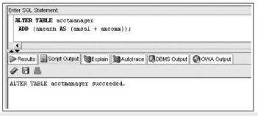
Virtual columns
Virtual columns appear to be normal table columns, but their values are derived rather than being stored on disc.
Oracle 11g

Slide 16
Try it out. . .
ADD A VIRTUAL COLUMN
ALTER TABLE acctmanager
  ADD amearn AS (amsal + amcomm));
VIEW THE TABLE
SELECT *
  FROM acctmanager;
TRY TO INSERT A VALUE INTO THAT VIRTUAL COLUMN
INSERT INTO acctmanger (amid, amfirst, amlast, amsal, amcomm, region, amearn)
VALUES (‘D500’, ‘SCOTT’, ‘DAVIS’, 53000, 6000, ‘SE’, 59000)
Oracle 11g
Notes:
ALTER TABLE acctmanager
ADD amearn AS (amsal + amcomm));
SELECT *
FROM acctmanager;
INSERT INTO acctmanger (amid, amfirst, amlast, amsal, amcomm, region, amearn)
VALUES (‘D500’, ‘SCOTT’, ‘DAVIS’, 53000, 6000, ‘SE’, 59000)

Slide 17
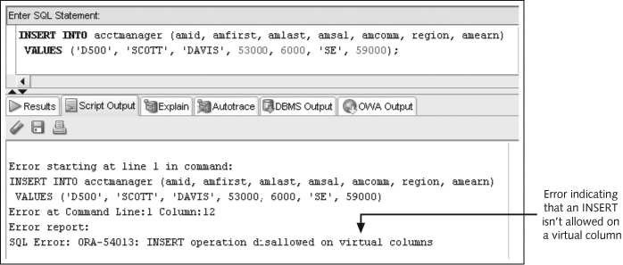
Manage Virtual Column Input
©2016. Cengage Learning. All rights reserved.

Slide 18
Constraint Violations
When you add or modify table data, the data is checked for compliance with any applicable constraints
©2016. Cengage Learning. All rights reserved.

Slide 19
SINGLE QUOTES
When trying to add a single quote into a name the program reads it as a closing quote in the string
Put 2 single quotes (‘’), and the program will interpret it as a single quote in the data. Be sure not to use double quotes.
INSERT INTO acctmanger (amid, amfirst, amlast, amsal, amcomm, region, amearn)
VALUES (‘M500’, ‘PEG’, ‘O’’HARE’, 46000, 2000, ‘SW’)

Slide 20
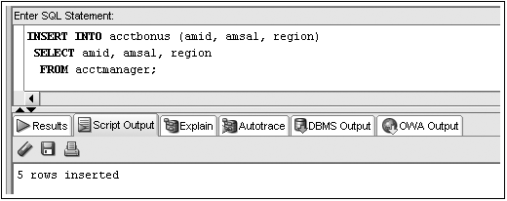
Inserting Data from an Existing Table
Substitute subquery for VALUES clause
SELECT * FROM acctbonus;
Subquery
©2016. Cengage Learning. All rights reserved.

Slide 21
Modifying Existing Rows
Modify rows using UPDATE command
Use UPDATE command to:
  Add values to an existing row (replace NULL values)
  Change existing values (i.e. new whole sale price changes the retail cost)
©2016. Cengage Learning. All rights reserved.

Slide 22
UPDATE Command
UPDATE clause identifies table
SET clause identifies column(s) being changed and new value(s)
Optional WHERE clause specifies row(s) to be changed – if omitted, all rows will be updated!
©2016. Cengage Learning. All rights reserved.

Slide 23

UPDATE Command Syntax
©2016. Cengage Learning. All rights reserved.

Slide 24
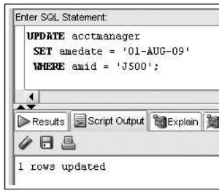
SELECT * FROM acctmanager;
SELECT * FROM acctmanager;

Slide 25
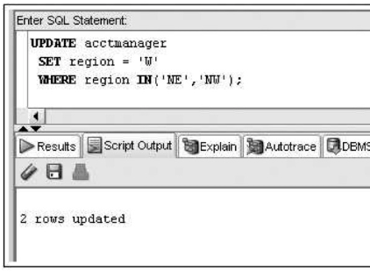
SELECT * FROM acctmanager;
Oracle 11g

Slide 26
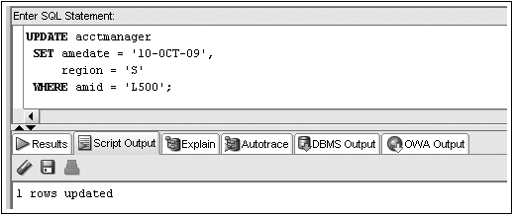
UPDATE Command Example
©2016. Cengage Learning. All rights reserved.

Slide 27
Substitution Variables
Prompts user for value
Identified by ampersand (&) preceding variable name
Can be used to create interactive scripts
©2016. Cengage Learning. All rights reserved.

Slide 28
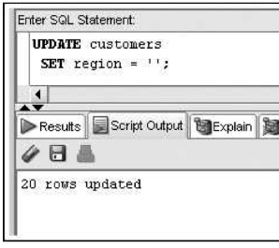
SELECT * FROM acctmanager;
Oracle 11g

Slide 29
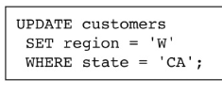
Oracle 11g

Slide 30
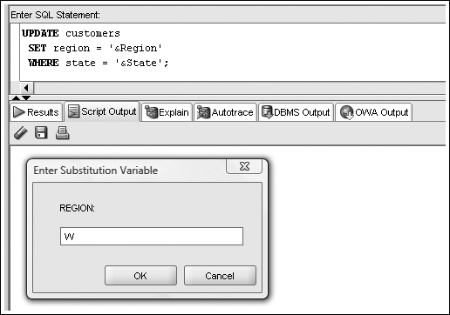
Substitution Variable Example
©2016. Cengage Learning. All rights reserved.

Slide 31
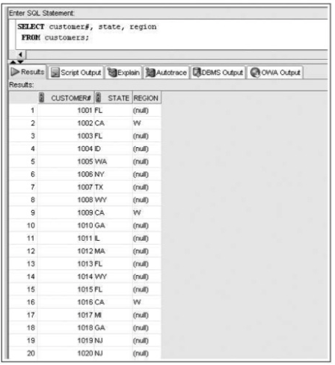

Slide 32
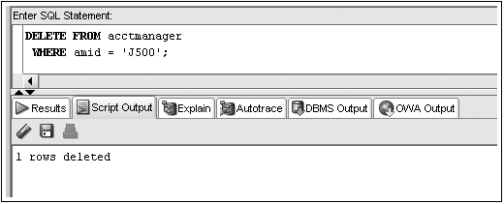
Deleting Rows
DELETE command removes a row from a table
WHERE clause determines which row(s) are removed
SELECT * FROM acctmanager;
©2016. Cengage Learning. All rights reserved.

Slide 33
DELETE Command – Omitting WHERE Clause
Omitting WHERE clause removes all rows
©2016. Cengage Learning. All rights reserved.

Slide 34
Transaction Control Statements
Results of data manipulation language (DML) are not permanently updated to a table until explicit or implicit COMMIT occurs
Transaction control statements can:
  Commit data through COMMIT command
  Undo data changes through ROLLBACK command
©2016. Cengage Learning. All rights reserved.

Slide 35
COMMIT Command
Explicit COMMIT occurs by executing COMMIT;
Implicit COMMIT occurs when DDL command is executed or user properly exits system
Permanently updates table(s) and allows other users to view changes
©2016. Cengage Learning. All rights reserved.

Slide 36
ROLLBACK Command
Used to “undo” changes that have not been committed
Occurs when:
  ROLLBACK; is executed
  System restarts after a crash
SAVEPOINT marks a specific spot within the transaction
Can ROLLBACK to a SAVEPOINT to undo part of the transaction
©2016. Cengage Learning. All rights reserved.

Slide 37
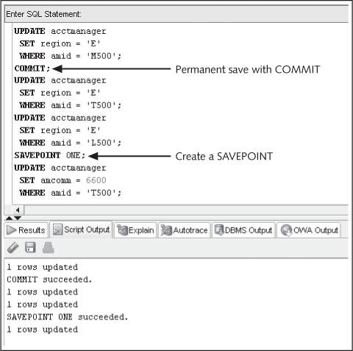

Transaction Control Example
©2016. Cengage Learning. All rights reserved.

Slide 38
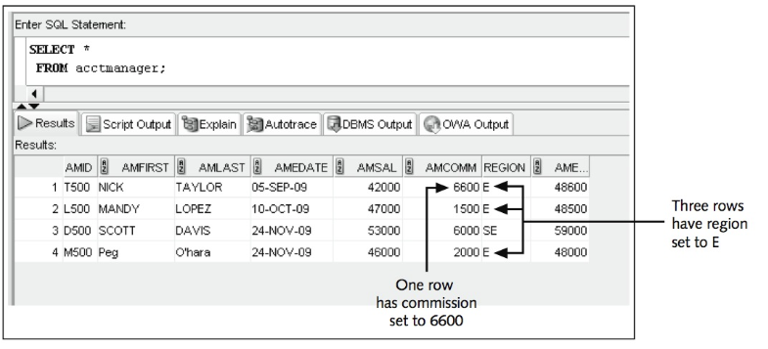
Oracle 11g

Slide 39
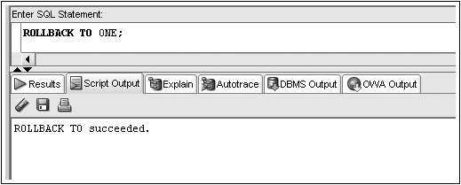
Transaction Control Example (continued)
Only undo DML actions after SAVEPOINT
©2016. Cengage Learning. All rights reserved.

Slide 40
Table Locks
Prevent users from changing same data or objects
Two types
  Shared – prevents DML operations on a portion of table
  Exclusive – locks table preventing other exclusive or shared locks
©2016. Cengage Learning. All rights reserved.

Slide 41
LOCK TABLE Command Shared Lock
Locks portion of table affected by DML operation
Implicitly occurs during UPDATE or DELETE operations
Explicitly occurs through LOCK TABLE command with SHARE MODE option
Released when COMMIT (implicit or explicit) or ROLLBACK occurs
©2016. Cengage Learning. All rights reserved.

Slide 42
LOCK TABLE Command Exclusive Lock
Implicitly locks table for DDL operations – CREATE or ALTER TABLE
Explicitly locked through LOCK TABLE command with EXCLUSIVE MODE option
Released after execution of DDL operation or after user exits system
©2016. Cengage Learning. All rights reserved.

Slide 43
SELECT…FOR UPDATE Command
Creates shared lock on retrieved portion of table
Prevents one user from changing a row while another user is selecting rows to be changed
Released through implicit or explicit commit
©2016. Cengage Learning. All rights reserved.

Slide 44

SELECT…FOR UPDATE Command Syntax
©2016. Cengage Learning. All rights reserved.

Slide 45
Summary
Data manipulation language (DML) includes the INSERT, UPDATE, DELETE, COMMIT, and ROLLBACK commands
The INSERT INTO command is used to add new rows to an existing table
The column list specified in the INSERT INTO clause must match the order of data entered in the VALUES clause
A virtual column must be ignored in all DML actions because the database system generates this column value automatically
You can use a NULL value in an INSERT INTO command by including the keyword NULL, omitting the column from the column list of the INSERT INTO clause, or entering two single quotes (without a space) in the position of the NULL value
©2016. Cengage Learning. All rights reserved.

Slide 46
Summary (continued)
To assign a DEFAULT option value, a column must be excluded from the column list in an INSERT statement or the keyword DEFAULT must be included as the value for the column
In a DML statement, two single quotes together must be used to represent a single quote in a value
If rows are copied from a table and entered in an existing table by using a subquery in the INSERT INTO command, the VALUES clause must be omitted because it’s irrelevant
You can change the contents of a row or group of rows with the UPDATE command
You can use substitution variables to allow you to execute the same command several times with different data values
©2016. Cengage Learning. All rights reserved.

Slide 47
Summary (continued)
DML operations aren’t stored permanently in a table until a COMMIT command is issued implicitly or explicitly
A transaction consists of a set of DML operations committed as a block
Uncommitted DML operations can be undone by issuing the ROLLBACK command
A SAVEPOINT serves as a marker for a point in a transaction and allows rolling back only a portion of the transaction
Use the DELETE command to remove records from a table; if the WHERE clause is omitted, all rows in the table are deleted
Table locks can be used to prevent users from mistakenly overwriting changes made by other users
©2016. Cengage Learning. All rights reserved.

Slide 48
Summary (continued)
Table locks can be in SHARE mode or EXCLUSIVE mode
EXCLUSIVE mode is the most restrictive table lock and prevents any other user from placing any locks on the same table
A lock is released when a transaction control statement is issued, a DDL statement is executed, or the user exits the system by using the EXIT command
SHARE mode allows other users to place shared locks on other portions of the table, but it prevents users from placing an exclusive lock on the table
The SELECT . . . FOR UPDATE command can be used to place a shared lock for a specific row or rows; the lock isn’t released unless a DDL command is issued or the user exits the system
©2016. Cengage Learning. All rights reserved.

